Slide 1
Git

Slide 2
Agenda
 | Git Getting started & basics
 | Git More git basics
 | Lunch break Git something to eat
 | Git Branches
 | Git Undoing

Slide 3
Guidelines
Participate “Don’t be afraid to look like an idiot”
Really participate
Be nice One person talks at a time… Use your sense of humour
Take all phone calls and text messages outside Or even better, use the breaks unless an emergency
Periodically discuss how the meeting is going
What’s important for you?

Slide 4
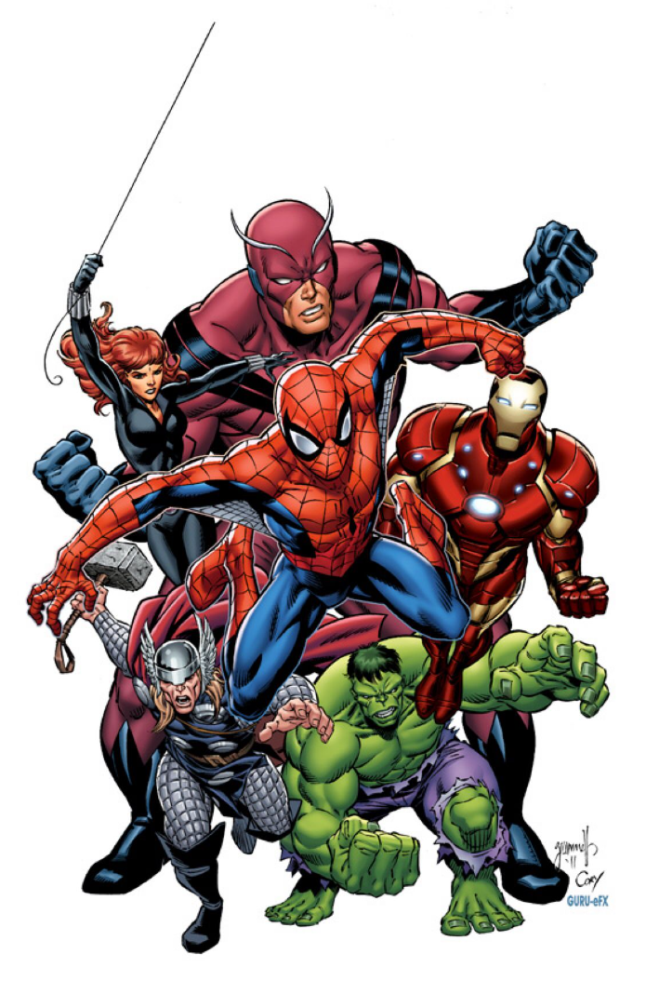
Git to know each other
The (hopefully) fun way
Name
Alias
If you had a superpower? Why?
One question that, if answered, makes this training worth-while?
One git command

Slide 5
Objectives
Be familiar with git on a theoretical level
Use the most usual 12 git commands
Undo Mistakes After some thorough Googling usually
Have an overview of advanced git
Become curious And save your diary in git

Slide 6
Getting Started
and “What’s in in for me?”

Slide 7
Version control system v0.1
my_code.java
my_code_v2.java
my_code_v3.java
my_code_v3_23Jul2022.java
my_code_v3_23Jul2022.java
my_code_v4.java
my_code_v4_final.java
my_code_v4_final_final.java
my_code_v4_final_update_1Aug2022.java

Slide 8
Exercise
A world without version control
1 2 3 4 5 6 7 8 9 10
1 2 4 3 6 4 8 5 10 6 12 7 14 8 16 9 10
Indigo

Slide 9
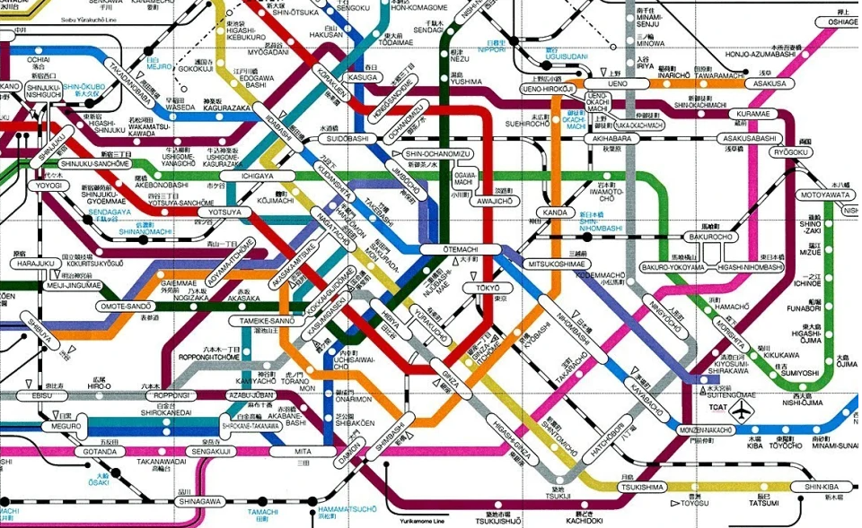
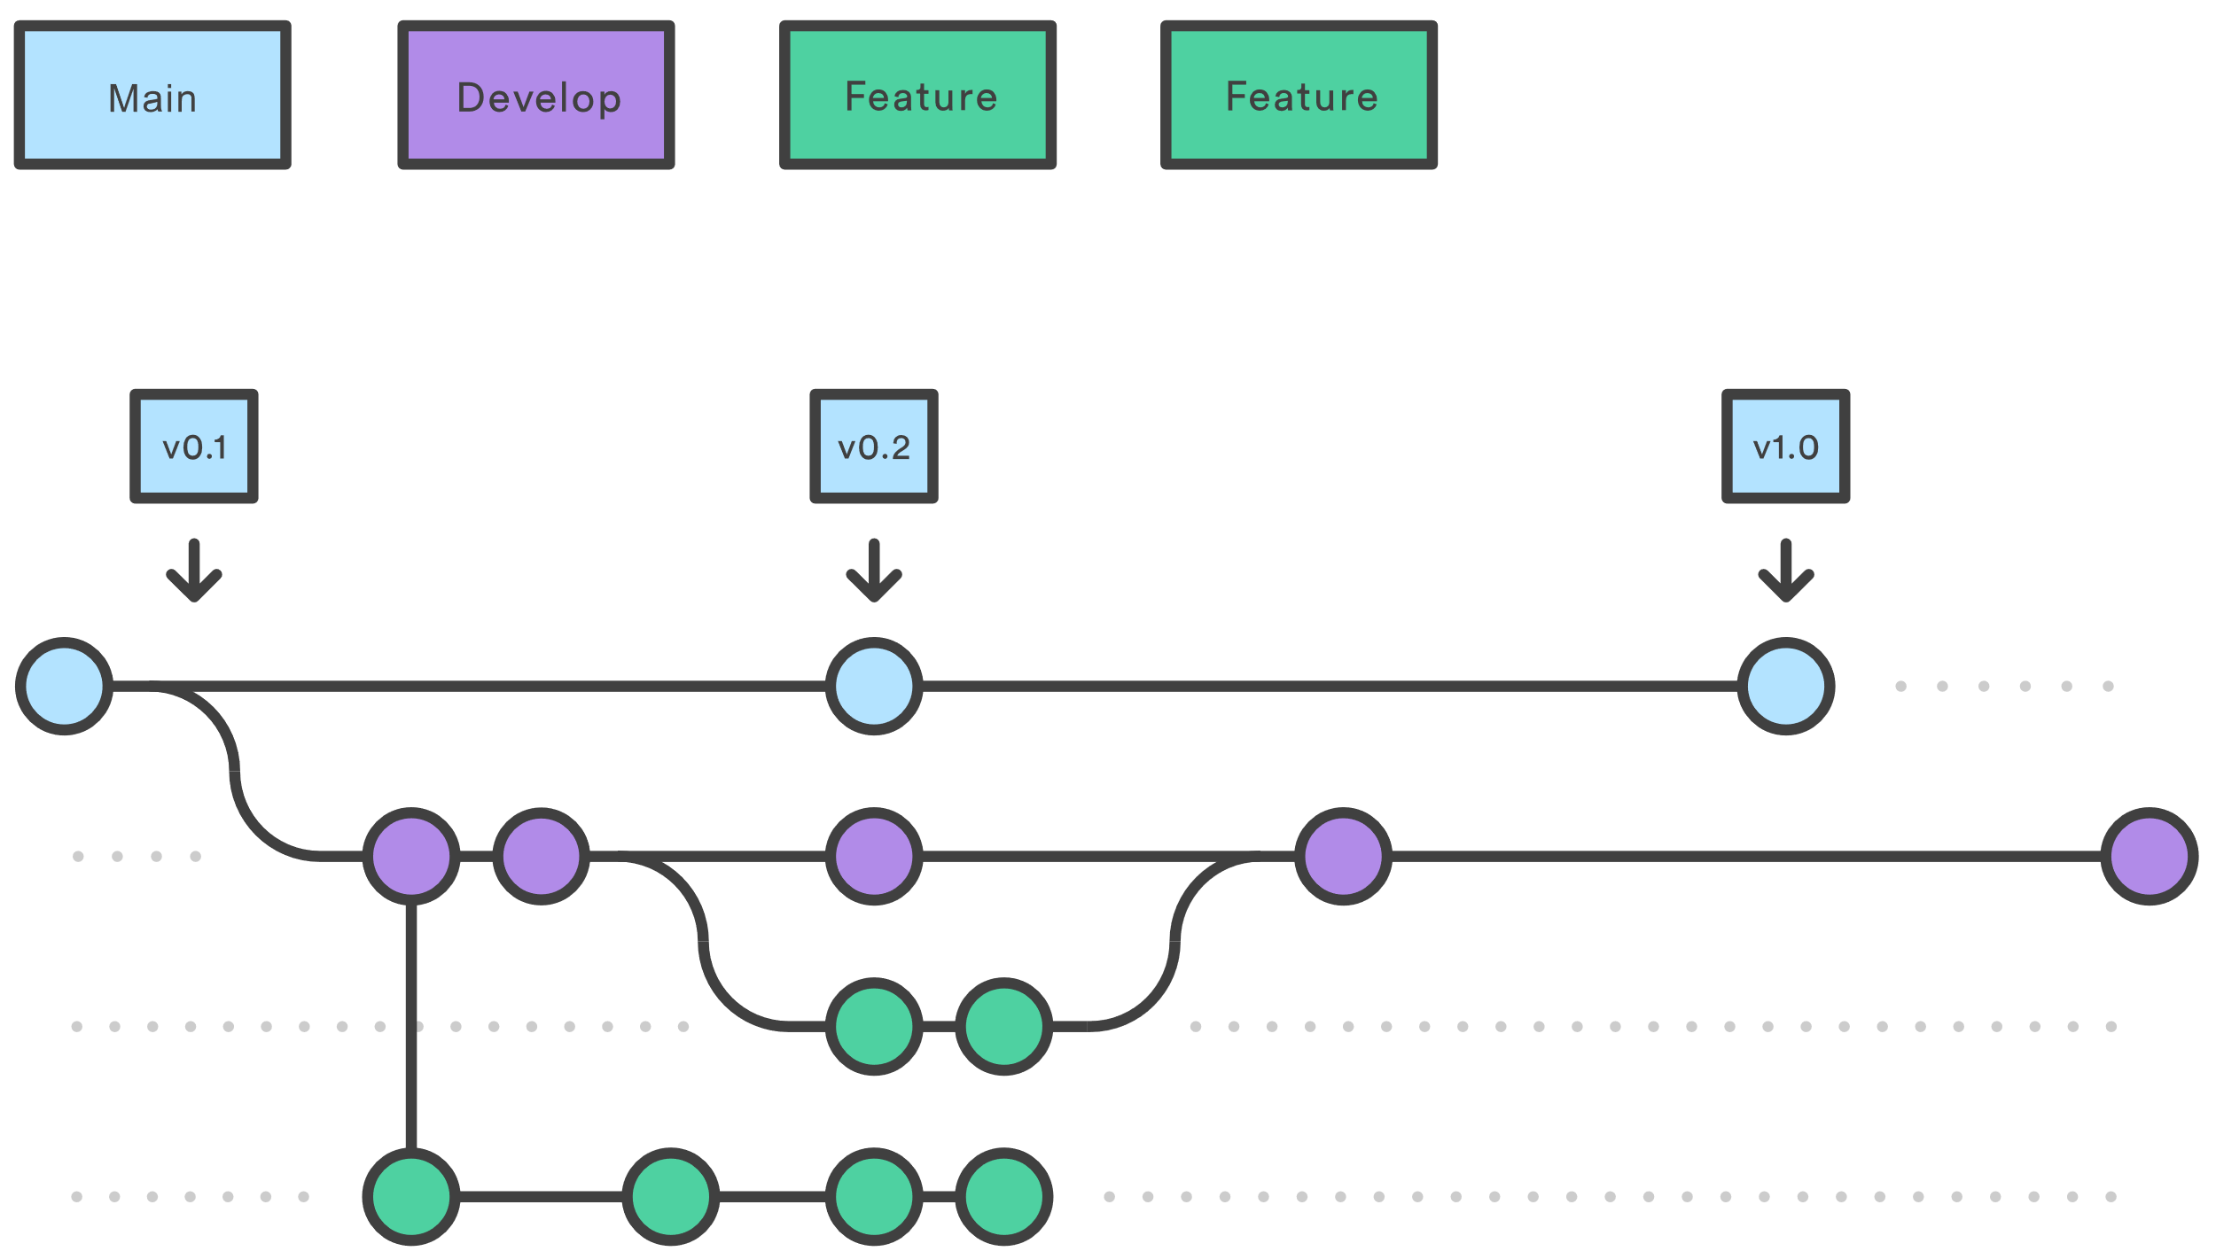
Chaos vs VCS

Slide 10
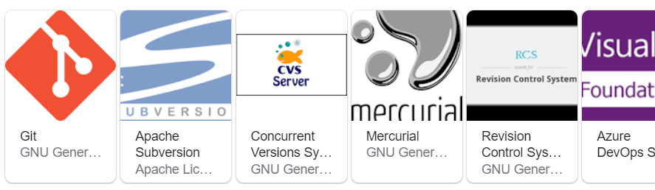
Other VCS?

Slide 11

Why GIT?

Slide 12
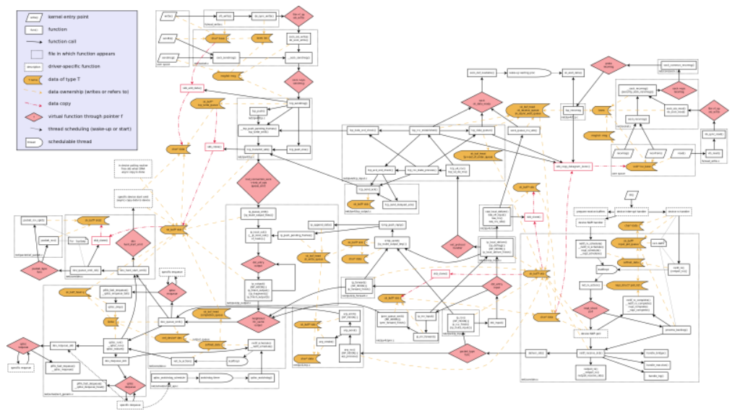
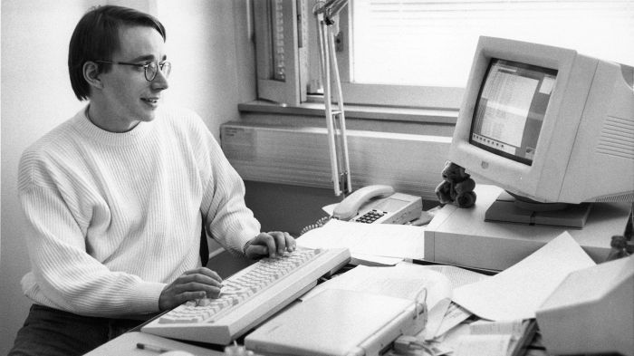
Git history

Slide 13
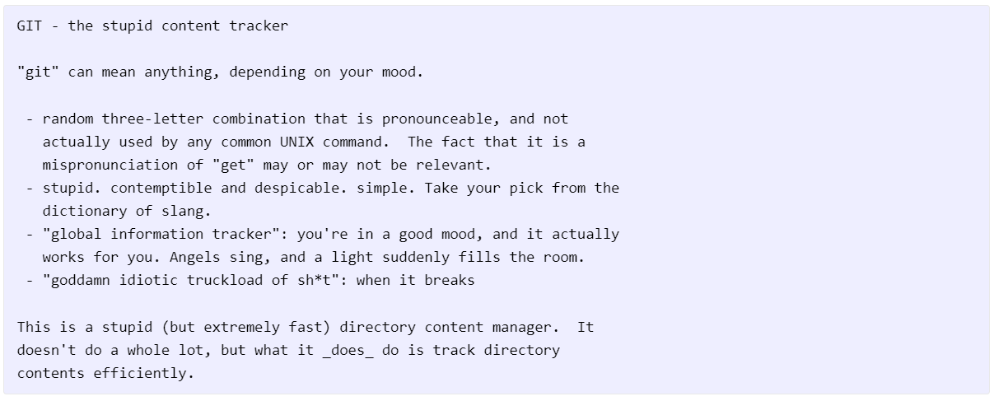
Why “git”

Slide 14

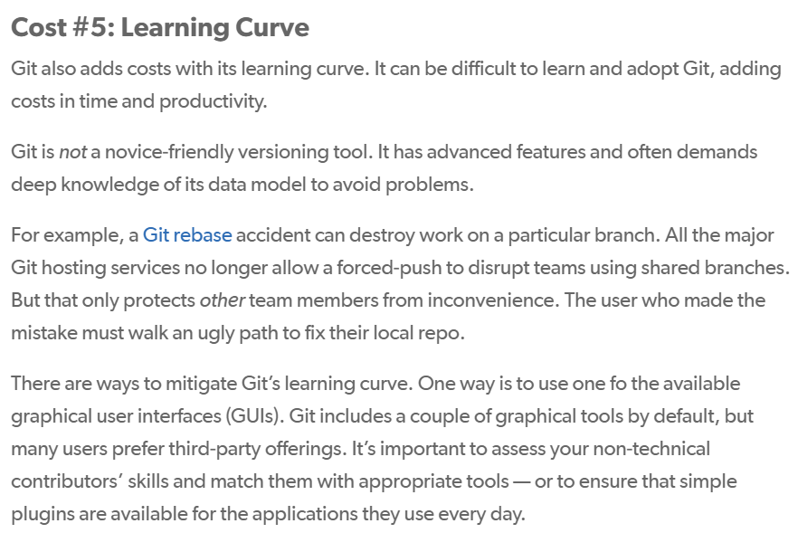
But…
Snapshots, not differences
Nearly Every Operation Is Local
Git Has Integrity
Git Generally Only Adds Data
Free and Open Source…

Slide 15
SHA-1
24b9da6552252987aa493b52f8696cd6d3b00373

Slide 16
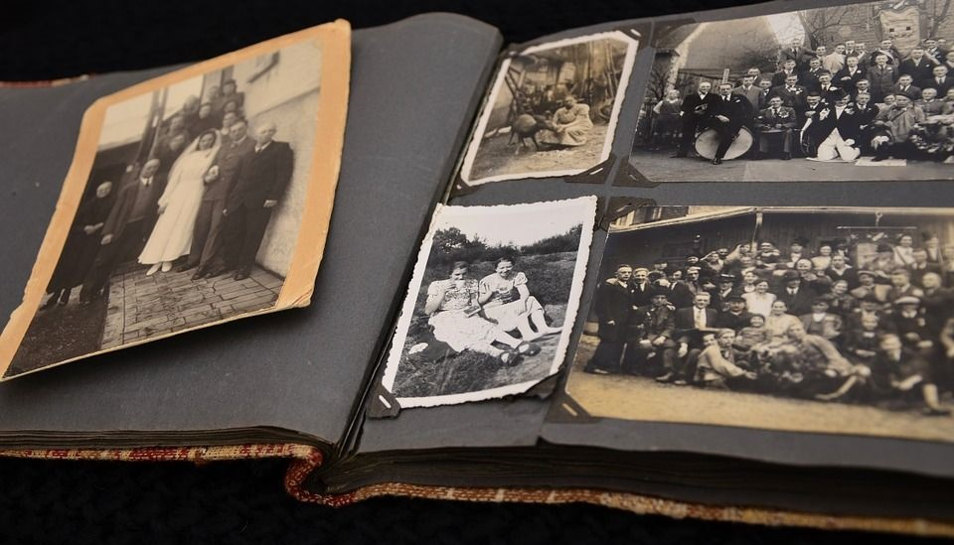
Photo Album

Slide 17
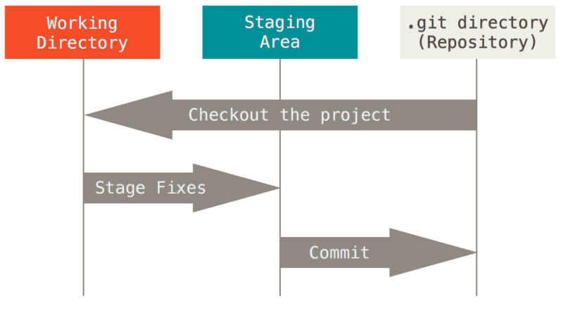
The Three Stages
aka The Most Important Slide
Index
Cache

Slide 18
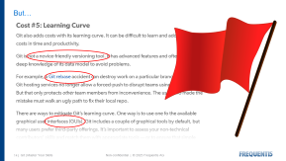
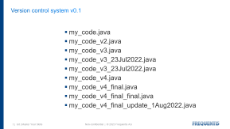


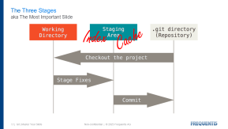
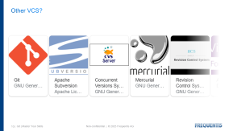
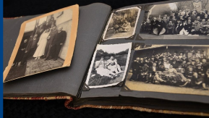
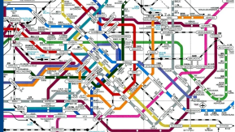
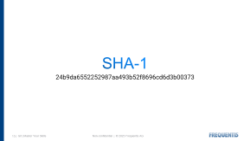
Recap

Slide 19
Q & A

Slide 20
Basics
hands on!

Slide 21



The Command Line
one can use all Git commands
all users will have command-line tools installed
feedback is informative

Slide 22
In what capacity are you using git?
Individual Developer (Standalone)
Individual Developer (Participant)
Integrator
Repository Administrator

Slide 23
First-time git setup
Check Your Settings
$ git config --list
Change Your Identity
$ git config ––list | grep user
$ git config ––global user.name “John Doe”
$ git config ––global user.email johndoe@example.com
Change Your Editor
we will use IntelliJ
Change Your Diff Tool
we will use IntelliJ
Check Your Settings (including version)

Slide 24
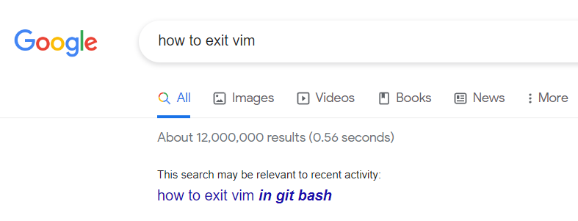
Basic shell commands
pwd
ls
cd
rm
cat
echo
vim
dir

Slide 25

Getting Help
git help <command> - C:\Program Files\Git\mingw64\share\doc\git-doc
git <command> --help
man git-<command>
Atlassian – Getting Git Right
Google!!!
Practice…

Slide 26

Basic Git Commands
init
clone
add
commit
status
diff
log
checkout
branch
merge
push
pull

Slide 27
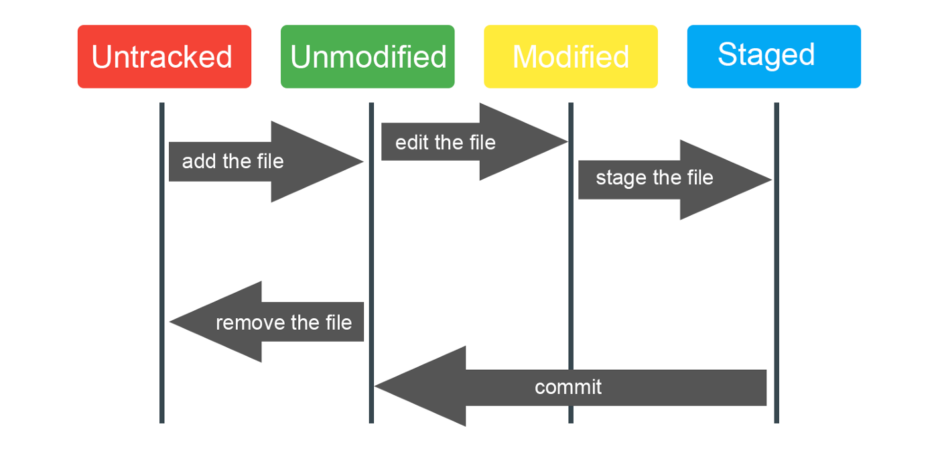
Git Status Lifecycle

Slide 28
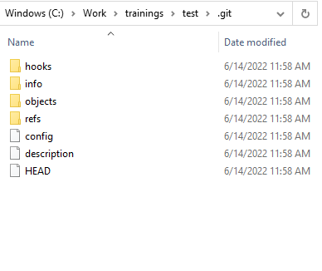
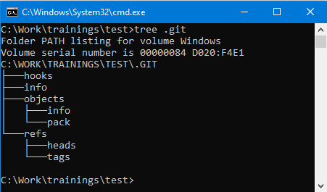
Starting a Git repository
git init
git clone

Slide 29
Get stuff done
git add
git commit

Slide 30
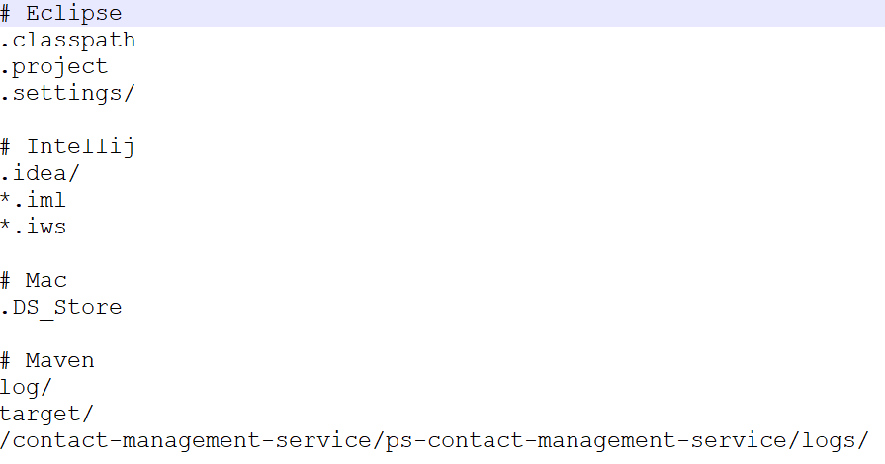
Ignoring Files

Slide 31
Removing files
git rm

Slide 32
Guidelines
Separate subject (50 characters or less) from body with a blank line
Do not end the subject line with a period “PLX-12345 Add readme file” instead of “PLX-12345 Add readme file.”
Capitalize the subject line and each paragraph “PLX-12345 Add readme file” instead of “PLX-12345 add readme file”
Use the imperative mood in the subject line “Add” instead of “Added”, “added”
Use the body to explain what and why If there’s something to explain
Wrap lines at 72 characters

Slide 33
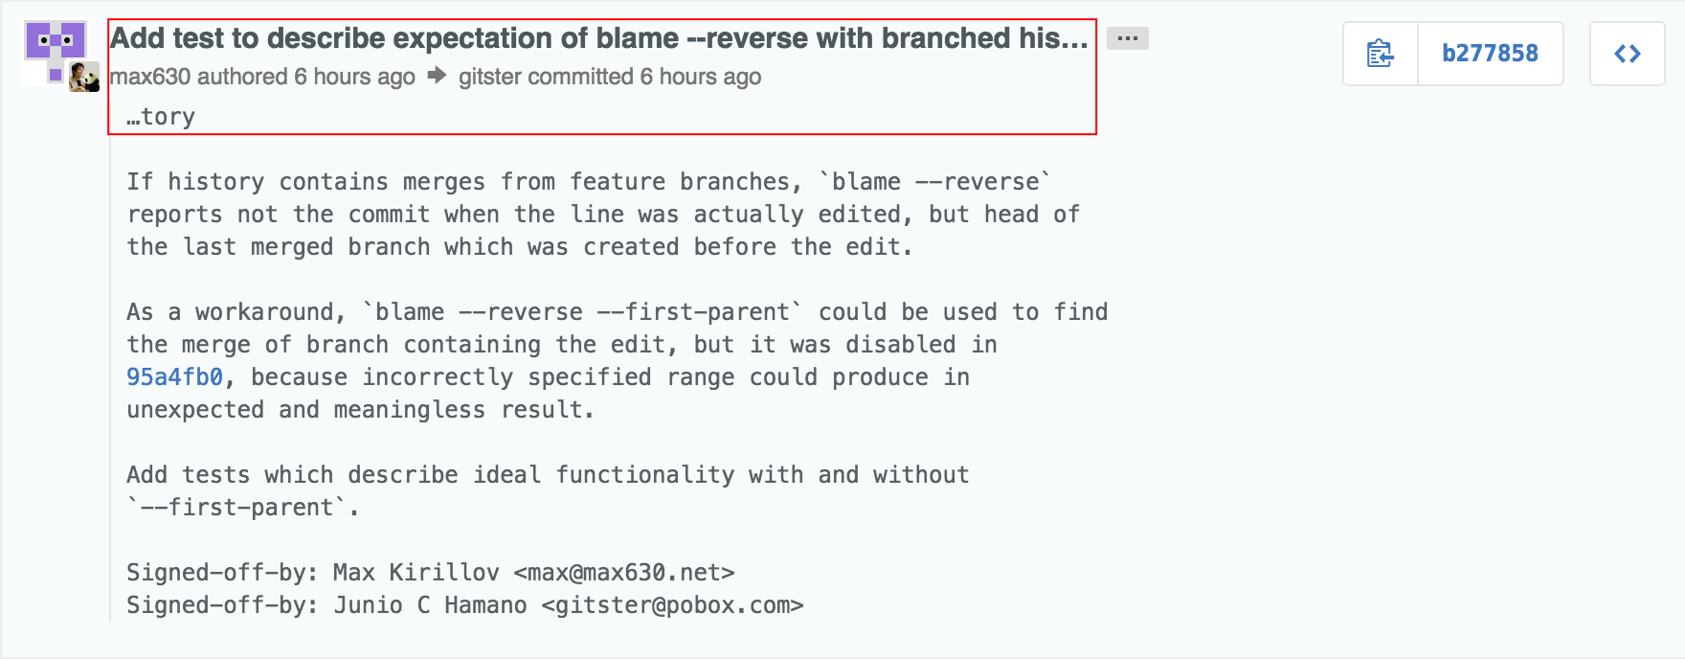
Git commit messages – short version
If applied, this commit will <your subject line here>

Slide 34
What have I done?
git diff
git log

Slide 35
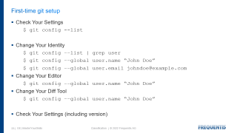
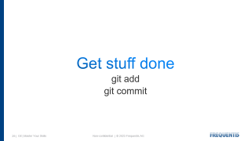
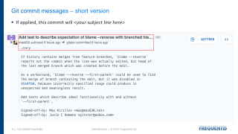
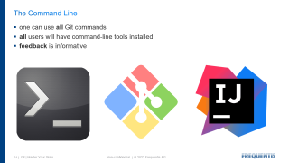
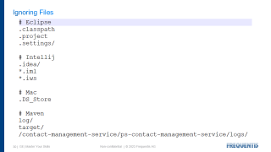
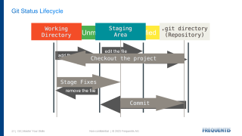
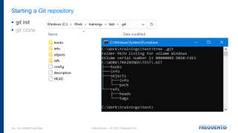

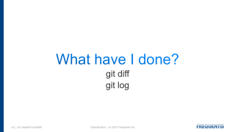
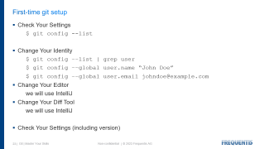








Recap

Slide 36
Q & A

Slide 37
Quiz
10 minutes

Slide 38
Branches
still hands on!

Slide 39
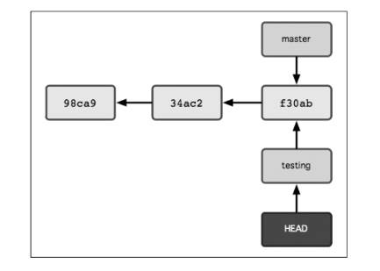
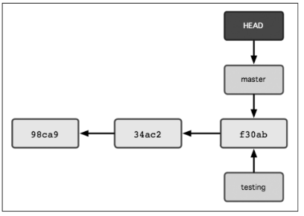
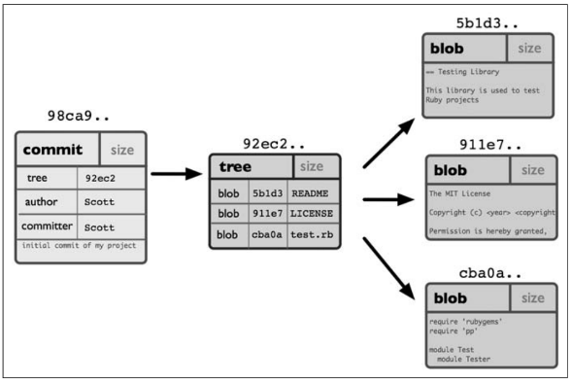
Plumbing

Slide 40
Basic Git Commands
init
clone
add
commit
status
diff
log
checkout
branch
merge
push
pull

Slide 41
Local branches
git branch “newBranch”

Slide 42
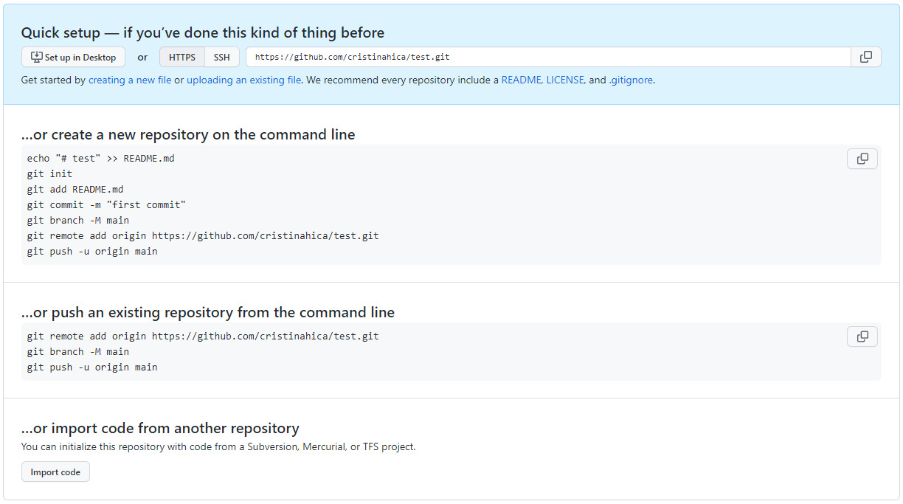
Quick Setup

Slide 43
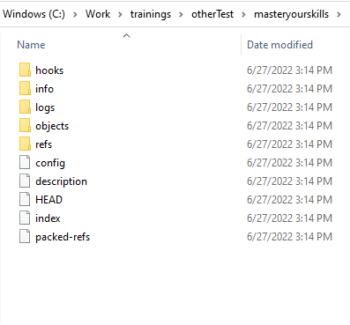
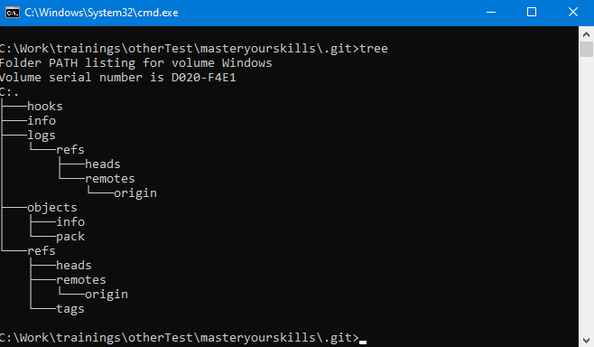
Getting a Git repository
git init
git clone

Slide 44
Working with others
fetch, pull, push

Slide 45
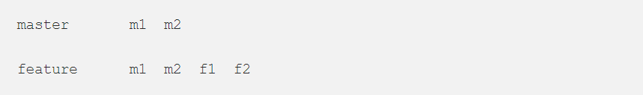
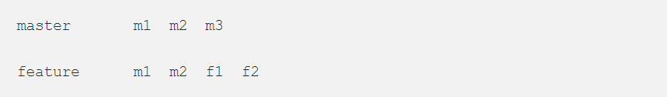
git merge
fast-forward vs recursive strategy
Fast-Forward
Recursive

Slide 46
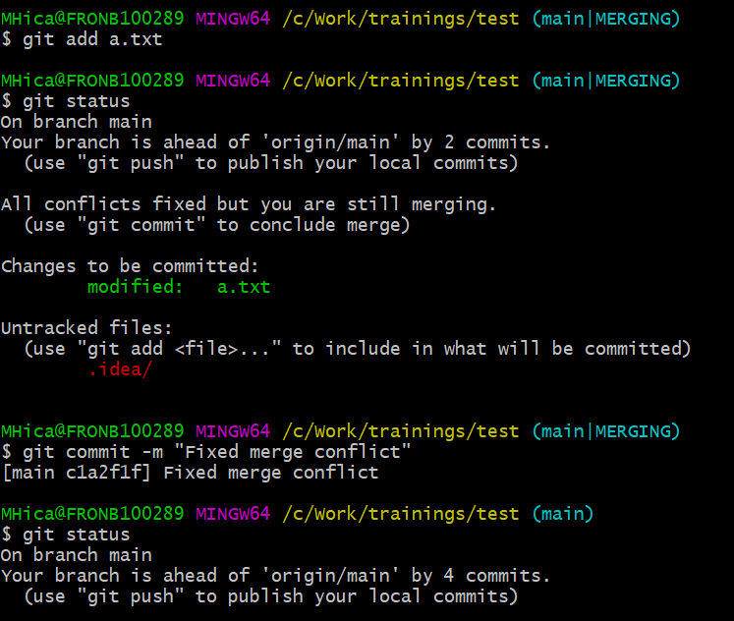
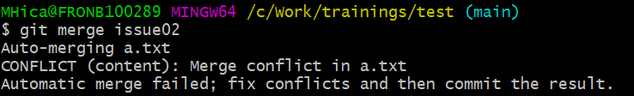
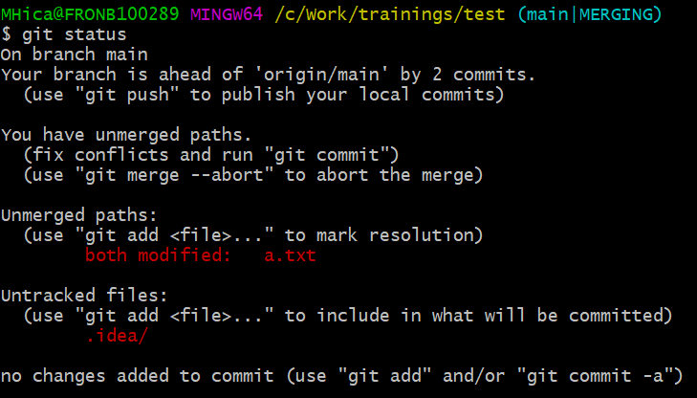
Merge Conflict

Slide 47
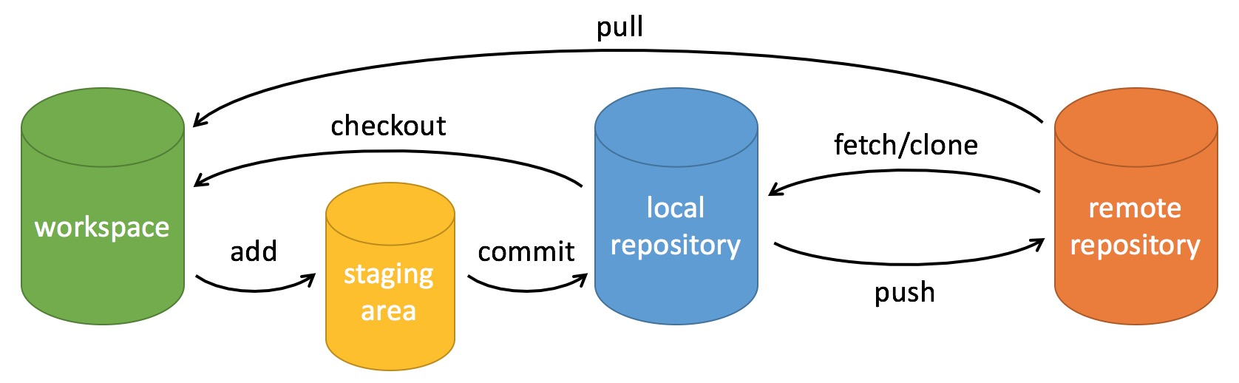
Remember the Three Stages?

Slide 48
Additional
git fork
git squash
git cherry-pick
git tag
git stash

Slide 49
Pull Requests

Slide 50
Q & A

Slide 51
Quiz
10 minutes

Slide 52
Undoing
still hands on!

Slide 53
Exercise
commit in the wrong branch
(don’t push please!)

Slide 54
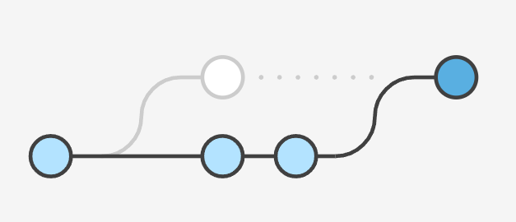
Fixing the Last Commit
"Holy moly! 😤 Too quick with that commit…
git commit --amend
Don’t amend public commits

Slide 55
Unstaging a (Staged) File
“I don’t want to commit that! …just yet 🤫“
git add <filename> antidote git restore –staged <filename>

Slide 56
Discarding All Local Changes in a File
"Oh my goodness! 🤔 When did I write that?!!"
git checkout HEAD readme.md

Slide 57
Restoring a Deleted File
"Heavens above! 😳 Why did I delete that?!!"
git checkout HEAD readme.md

Slide 58
Restoring a Deleted File NOT previously committed
“Well, I never! 😰 I meant commit not delete!!"
git checkout HEAD readme.md

Slide 59
Discarding All Local Changes
"Bloody hell! 🙈 Let’s start over!
git reset --hard HEAD

Slide 60
Reverting a Commit
“Deary me! 😩 How can I get rid of that commit?”
git revert d1deddf

Slide 61
Resetting everything to an Old Revision
“Good gravy! 😖 If I could turn back time…”
git reset --hard d1deddf
Don’t reset public history

Slide 62
Resetting a local file to an Old Revision
"Yikes! 🤔 I know this file was correct sometime!"
git checkout d1deddf -- readme.md

Slide 63
Recovering Deleted Commits
“Sweet baby Jesus! 😱 Did I just delete the wrong commits?!!
git reset --hard d1deddf
Don’t reset public history

Slide 64
Discarding Chunks / Lines in a File
“We don’t log passwords you say!?! 🙄"
git checkout -p readme.md

Slide 65
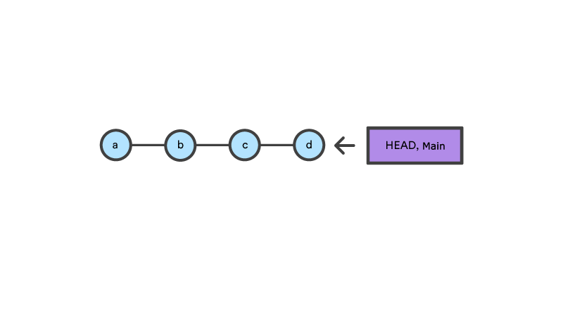
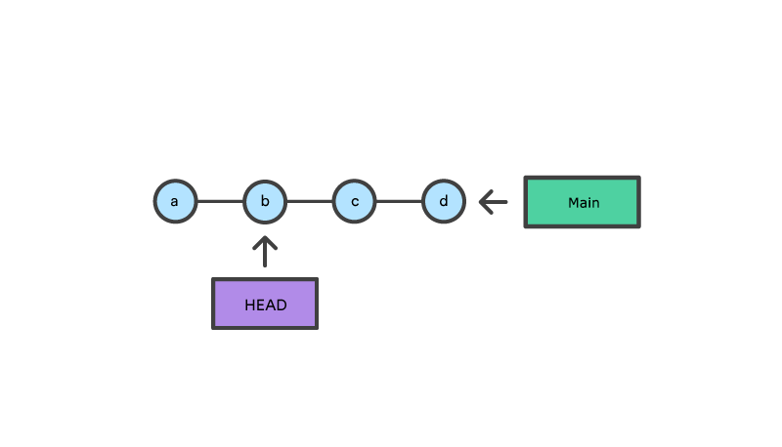
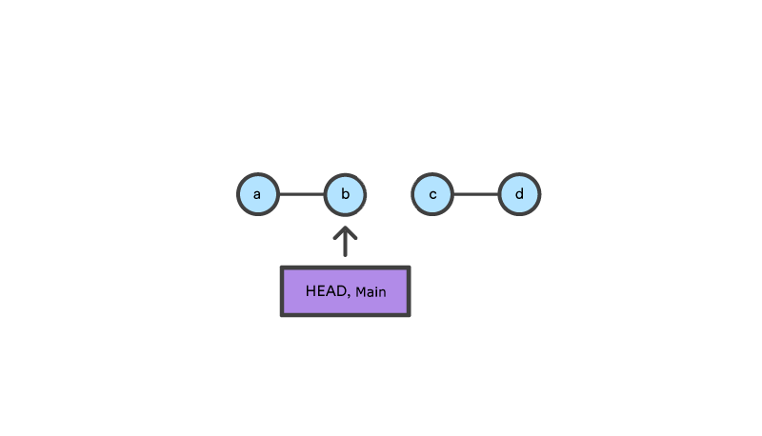
git reset vs git checkout
git checkout b
git reset b

Slide 66
Recap
One idea each

Slide 67
References
[Linux.conf.au 2013] - Git For Ages 4 And Up
computernetworkingnotes.com
https://initialcommit.com/blog/How-Did-Git-Get-Its-Name
Pro Git - Scott Chacon and Ben Straub (Git - Book (git-scm.com))
An Intro: Git and GitHub for Starters | by Yankee Maharjan | Leapfrog (lftechnology.com)
17 Ways to Undo Mistakes with Git | Tower Blog (git-tower.com)
Git: The Beginner's Guide to Understanding Core Version Control Concepts (freecodecamp.org)
learngitbranching.js.org

